Slide 1
Object-Oriented Software Engineering Practical Software Development using UML and Java
Chapter 6:
Using Design Patterns

Slide 2
Introduction to Patterns
The recurring aspects of designs are called design patterns.
A pattern is the outline of a reusable solution to a general problem encountered in a particular context
Many of them have been systematically documented for all software developers to use
A good pattern should
Be as general as possible
Contain a solution that has been proven to effectively solve the problem in the indicated context.
Studying patterns is an effective way to learn from the experience of others

Slide 3
Pattern description
Context:
The general situation in which the pattern applies
Problem:
A short sentence or two raising the main difficulty.
Forces:
The issues or concerns to consider when solving the problem
Solution:
The recommended way to solve the problem in the given context.
‘to balance the forces’
Antipatterns: (Optional)
Solutions that are inferior or do not work in this context.
Related patterns: (Optional)
Patterns that are similar to this pattern.
References:
Who developed or inspired the pattern.

Slide 4
The Abstraction-Occurrence Pattern
Context:
Often in a domain model you find a set of related objects (occurrences).
The members of such a set share common information
but also differ from each other in important ways.
Problem:
What is the best way to represent such sets of occurrences in a class diagram?
Forces:
You want to represent the members of each set of occurrences without duplicating the common information

Slide 5
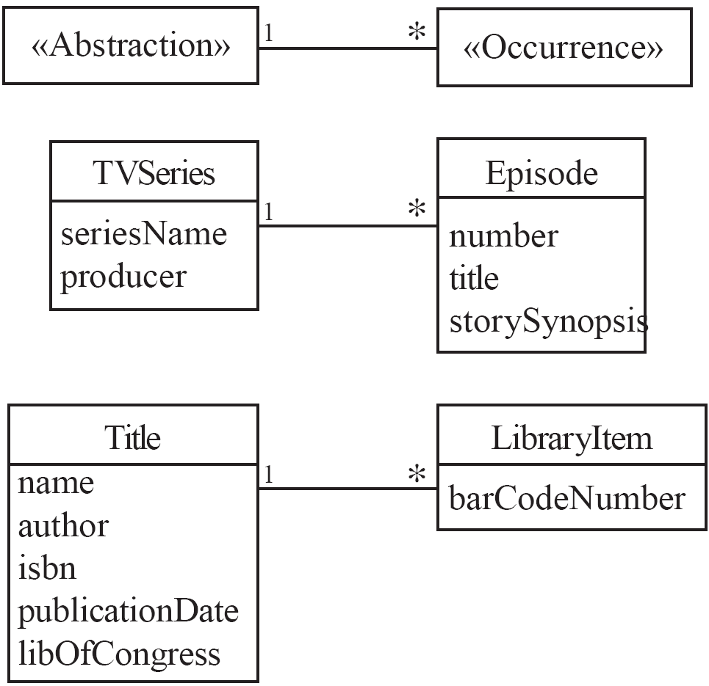
Abstraction-Occurrence
Solution:

Slide 6
The General Hierarchy Pattern
Context:
Objects in a hierarchy can have one or more objects above them (superiors),
and one or more objects below them (subordinates).
Some objects cannot have any subordinates
Problem:
How do you represent a hierarchy of objects, in which some objects cannot have subordinates?
Forces:
You want a flexible way of representing the hierarchy
that prevents certain objects from having subordinates
All the objects have many common properties and operations

Slide 7
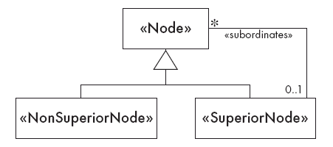
General Hierarchy
Solution:

Slide 8
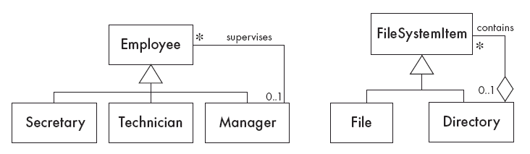
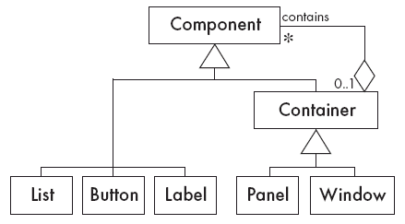
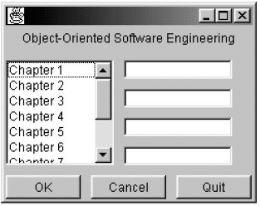
General Hierarchy
Solution:

Slide 9
The Player-Role Pattern
Context:
A role is a particular set of properties associated with an object in a particular context.
An object may play different roles in different contexts.
Problem:
How do you best model players and roles so that a player can change roles or possess multiple roles?

Slide 10
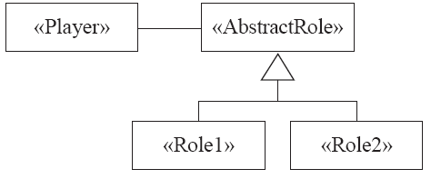
Player-Role
Forces:
It is desirable to improve encapsulation by capturing the information associated with each separate role in a class.
You want to avoid multiple inheritance.
You cannot allow an instance to change class
Solution:

Slide 11
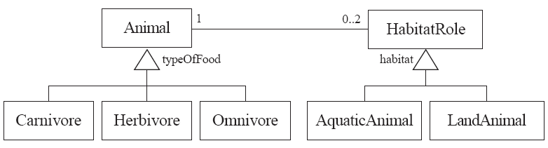
Player-Role
Example 1:

Slide 12
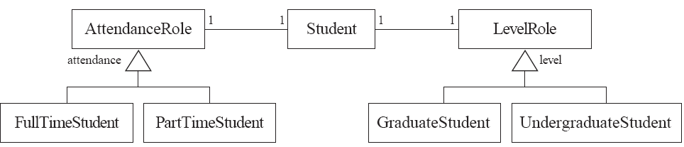
Player-Role
Example 2:

Slide 13
The Singleton Pattern
Context:
It is very common to find classes for which only one instance should exist (singleton)
Problem:
How do you ensure that it is never possible to create more than one instance of a singleton class?
Forces:
The use of a public constructor cannot guarantee that no more than one instance will be created.
The singleton instance must also be accessible to all classes that require it

Slide 14
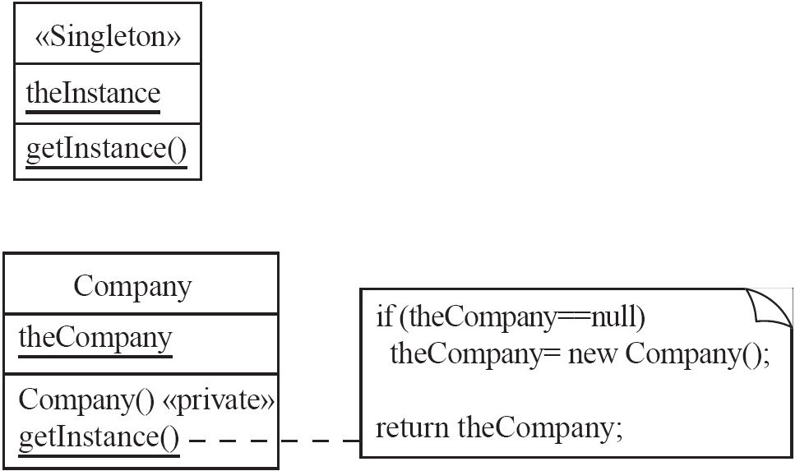
Singleton
Solution:

Slide 15
The Observer Pattern
Context:
When an association is created between two classes, the code for the classes becomes inseparable.
If you want to reuse one class, then you also have to reuse the other.
Problem:
How do you reduce the interconnection between classes, especially between classes that belong to different modules or subsystems?
Forces:
You want to maximize the flexibility of the system to the greatest extent possible

Slide 16
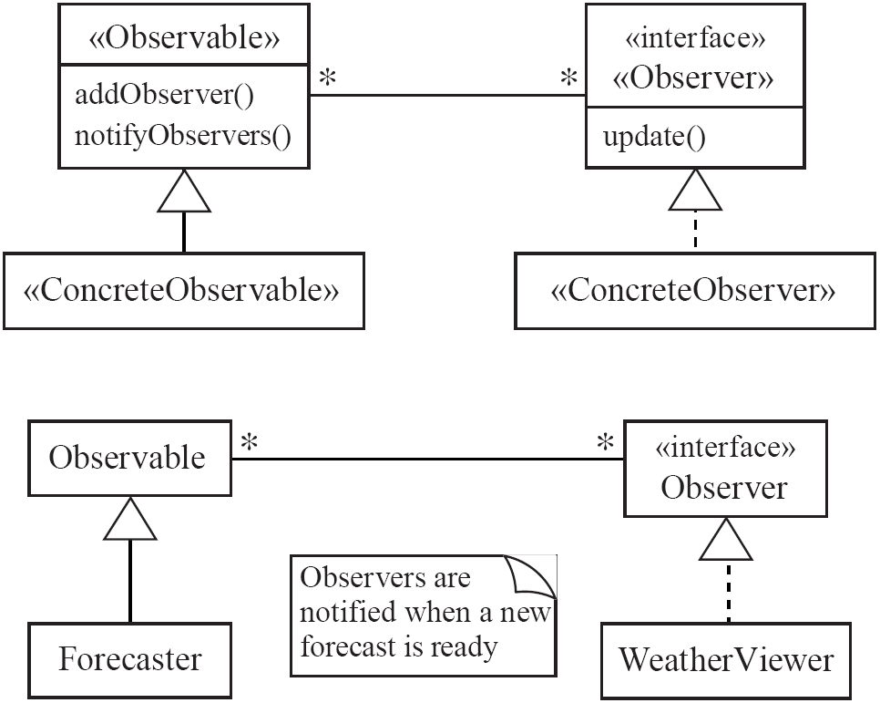
Observer
Solution:

Slide 17
The Delegation Pattern
Context:
You are designing a method in a class
You realize that another class has a method which provides the required service
Inheritance is not appropriate
E.g. because the isa rule does not apply
Problem:
How can you most effectively make use of a method that already exists in the other class?
Forces:
You want to minimize development cost by reusing methods

Slide 18
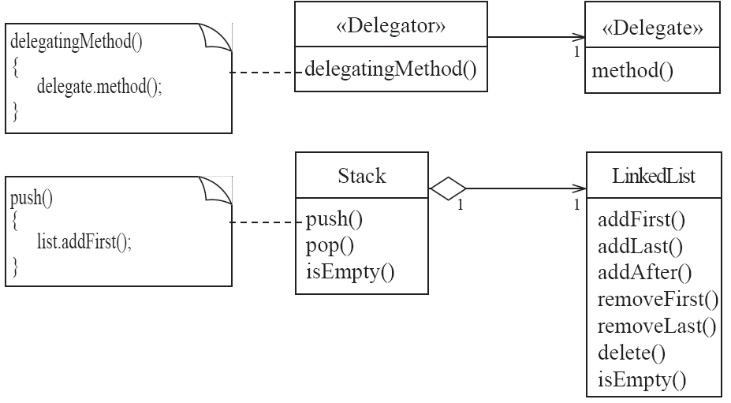
Delegation
Solution:

Slide 19
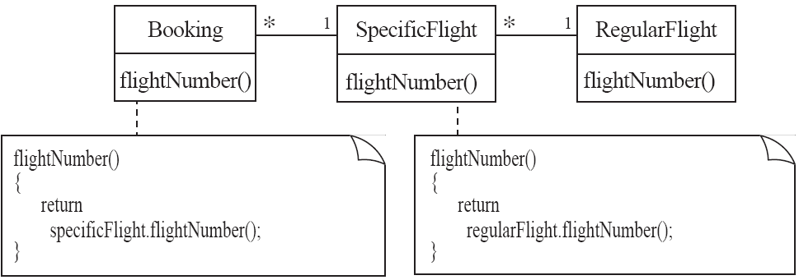
Delegation
Example:

Slide 20
The Adapter Pattern
Context:
You are building an inheritance hierarchy and want to incorporate into it an existing class.
The reused class is also often already part of its own inheritance hierarchy.
Problem:
How to obtain the power of polymorphism when reusing a class whose methods
have the same function
but not the same signature
as the other methods in the hierarchy?
Forces:
You do not have access to multiple inheritance or you do not want to use it.

Slide 21
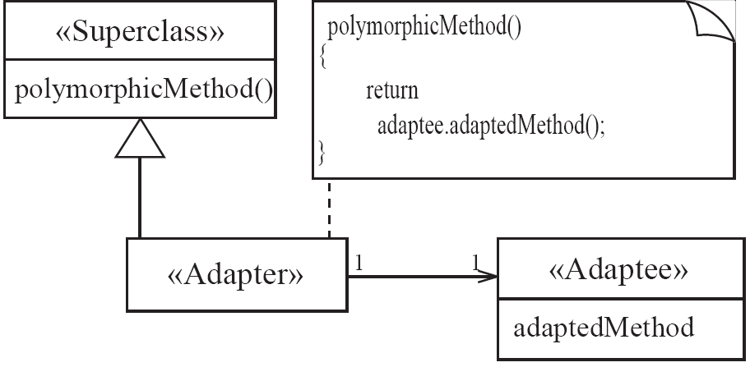
Adapter
Solution:

Slide 22
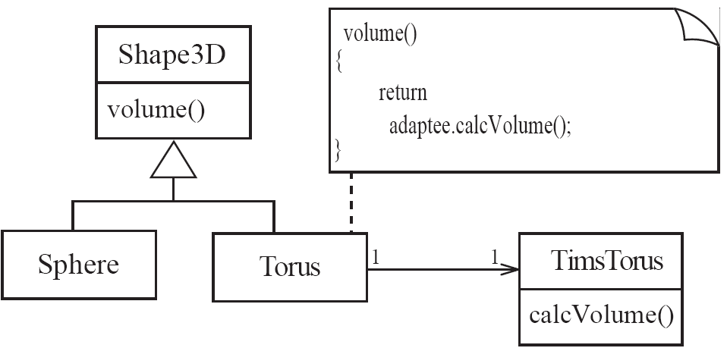
Adapter
Example:

Slide 23
The Façade Pattern
Context:
Often, an application contains several complex packages.
A programmer working with such packages has to manipulate many different classes
Problem:
How do you simplify the view that programmers have of a complex package?
Forces:
It is hard for a programmer to understand and use an entire subsystem
If several different application classes call methods of the complex package, then any modifications made to the package will necessitate a complete review of all these classes.

Slide 24
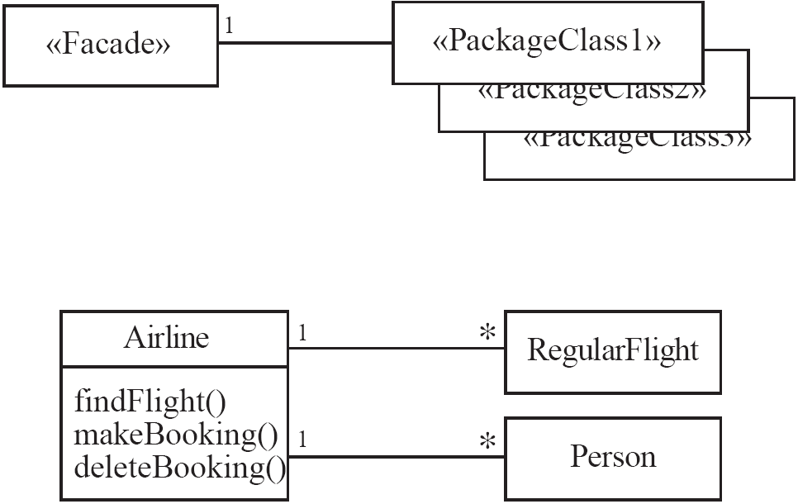
Façade
Solution:

Slide 25
The Read-only Interface Pattern
Context:
You sometimes want certain privileged classes to be able to modify attributes of objects that are otherwise immutable
Problem:
How do you create a situation where some classes see a class as read-only whereas others are able to make modifications?
Forces:
Restricting access by using the public, protected and private keywords is not adequately selective.
Making access public makes it public for both reading and writing

Slide 26
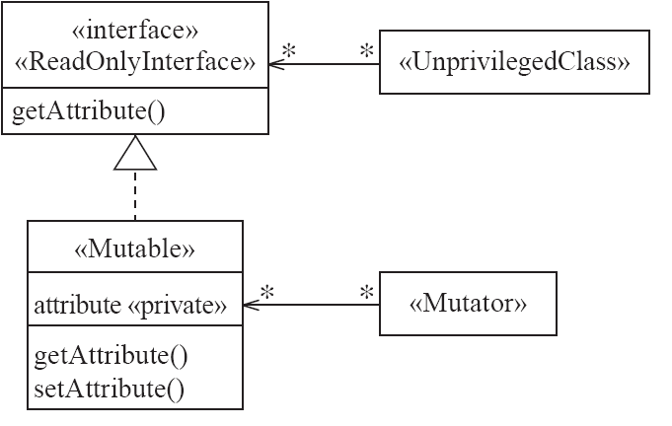
Read-only Interface
Solution:

Slide 27
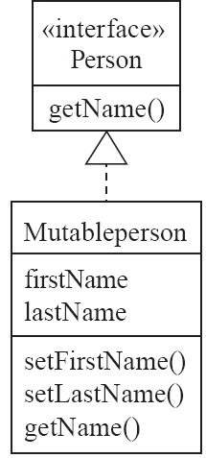
Read-only Interface
Example:

Slide 28
Difficulties and Risks When Creating Class Diagrams
Patterns are not a panacea:
Whenever you see an indication that a pattern should be applied, you might be tempted to blindly apply the pattern.
This can lead to unwise design decisions .
Resolution:
Always understand in depth the forces that need to be balanced, and when other patterns better balance the forces.
Make sure you justify each design decision carefully.

Slide 29
Difficulties and Risks When Creating Class Diagrams
Developing patterns is hard
Writing a good pattern takes considerable work.
A poor pattern can be hard to apply correctly
Resolution:
Do not write patterns for others to use until you have considerable experience both in software design and in the use of patterns.
Take an in-depth course on patterns.
Iteratively refine your patterns, and have them peer reviewed at each iteration.

